Slide 1


Slide 2
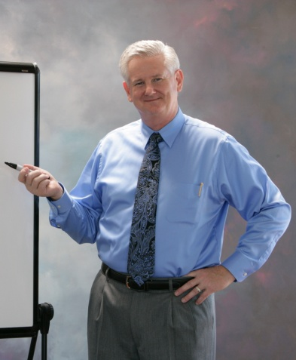

It all starts with an exceptional speaker.
RON CRABTREE
Operational Excellence & Business Process Improvement keynote and thought leader .
AREAS OF SPECIALTY:
Operationalized Marketing & Sales, Six Sigma Design, People CentrixTM Service, Organization Effectiveness
Voice-of Customer/Market, + + +.
Notes:
Talking Points:
Diversity of information: multiple areas of expertise
Number of hours/people taught/changed

Slide 3


Add a program by picking a style:
ENGAGING THE ROOM
Our programs are designed to teach the participants through hands-on interaction – we talk with, not at.
MANAGING CHANGE
Almost all speaking engagements share the goal of changing the way people think and do things – our presenters are change management experts.
Informative
Demonstrative
Persuasive
Entertaining
Or our specialty,
all of the above
Notes:
Talking Points:
Why interactivity works and how we take that beyond the live session into the recorded sessions through post-session surveys, Q&A, etc.

Slide 4
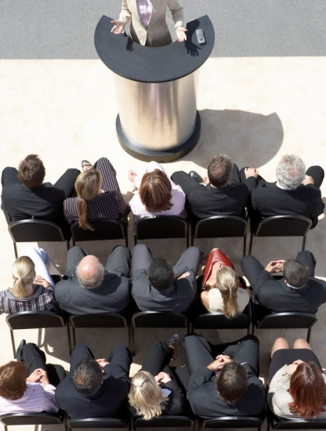

Select a format:
Keynote
Panel
Roundtable
Debate
Workshop
Webinar
Something of your own design
DESIGN FOR PURPOSE
Presentations should be formatted according to the desired takeaway and audience scope.
INNOVATE INTERACTIVITY
Even webinars have limitless capacity for interactivity from pre-reading assignments to shared online whiteboards, and discussion to polling.
Notes:
Talking Points:
How to use format to get the best attendee response/desired results
How format plays into the big picture of livecasting and recorded presentations

Slide 5


Sign us on to:
Design the event
Promote it
Augment your audience
Live cast and record it
Build bigger events from yours and others
Resell the events and recordings
PER SEAT COSTS
For live webcasting with all the basics like screen sharing, chat, surveys and polling, and recording as low as $5/person for 200+.
RECORDING RESELLING
Once we have the recorded event, we promote and resell it at no cost to you, and you get a percentage of the sales.
Notes:
Talking Points:
Initial investment in the actual event only, then residuals after that
We do as much or as little as you want us to, and the residuals will almost always pay you back for your investment

Slide 6
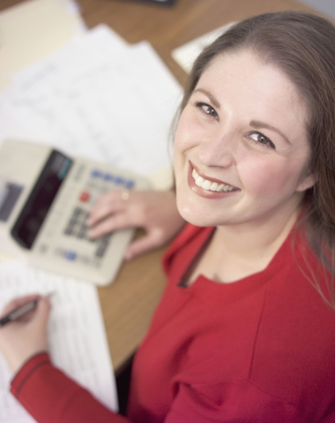

We share the proceeds from:
DOUBLE YOUR AUDIENCE
We supply the marketing to bring the number of participants to your event that double your original registration numbers in most cases.
DOUBLE YOUR ROI
It’s in the reselling… Between enhancing your attendee numbers and reselling the program, we’ll almost always double your goal.
The original event
The livecasts
The resulting conference sessions
The recorded presentations

Slide 7


We give back. Together we co-brand the event with you and package it so business associations can purchase and resell it to their memberships as association fundraisers.
SUSTAINABLE SALES
We repackage events together based on association goals to create current and goal-specific events that benefit memberships and raise funds.
BUILDING BRAND RECOGNITION
Because we co-brand each resold event with you, the association members credit your brand for delivering the event experience.

Slide 8

Why we do it.
We have unrivaled speakers & presenters.
We give back to the business community with current thought leadership.
We have the capacity to provide low cost, high impact marketing services.
It better establishes both of us as a go-tos for business process improvement.
We know how to make greater profits for you from your speaker-reliant events.
It brings the best companies together for creating current events.
We can give you better revenues from attendee numbers and residuals.
We know that the best of the best of everything comes from collaboration.

Slide 9

Let’s go get ‘em!

