Slide 1

Notes:
KIM’S COMMENTS
Revised pix but kept the same person to reflect intensity, they are serious, and diverse
We bring the old dogs up to speed – our sweet spot – we understand how to get into your WIIFM
Brain technology – the neuroscience of leadership… SEI recognizes that data is just a part not the whole…
DISCUSSION TOPICS
Social media big data is the BIG IT! There is already serious weariness, both operationally and financially, in dealing with SM data… that’s where we come in.
Even if you have had success with the data management part… how much success have you had with your teams actually using it optimally?
We’re way out in front of the social media data management and implementation pack…
Our system reduces the social media management fatigue all organizations are suffering from…
We solve complex problems – social media data management is complex – and make the problems into assets
SEI is about people, technology and process – Making the three into the best value for business is our specialty
SEI is designed to snap to the grid of business’ strategic objectives

Slide 2
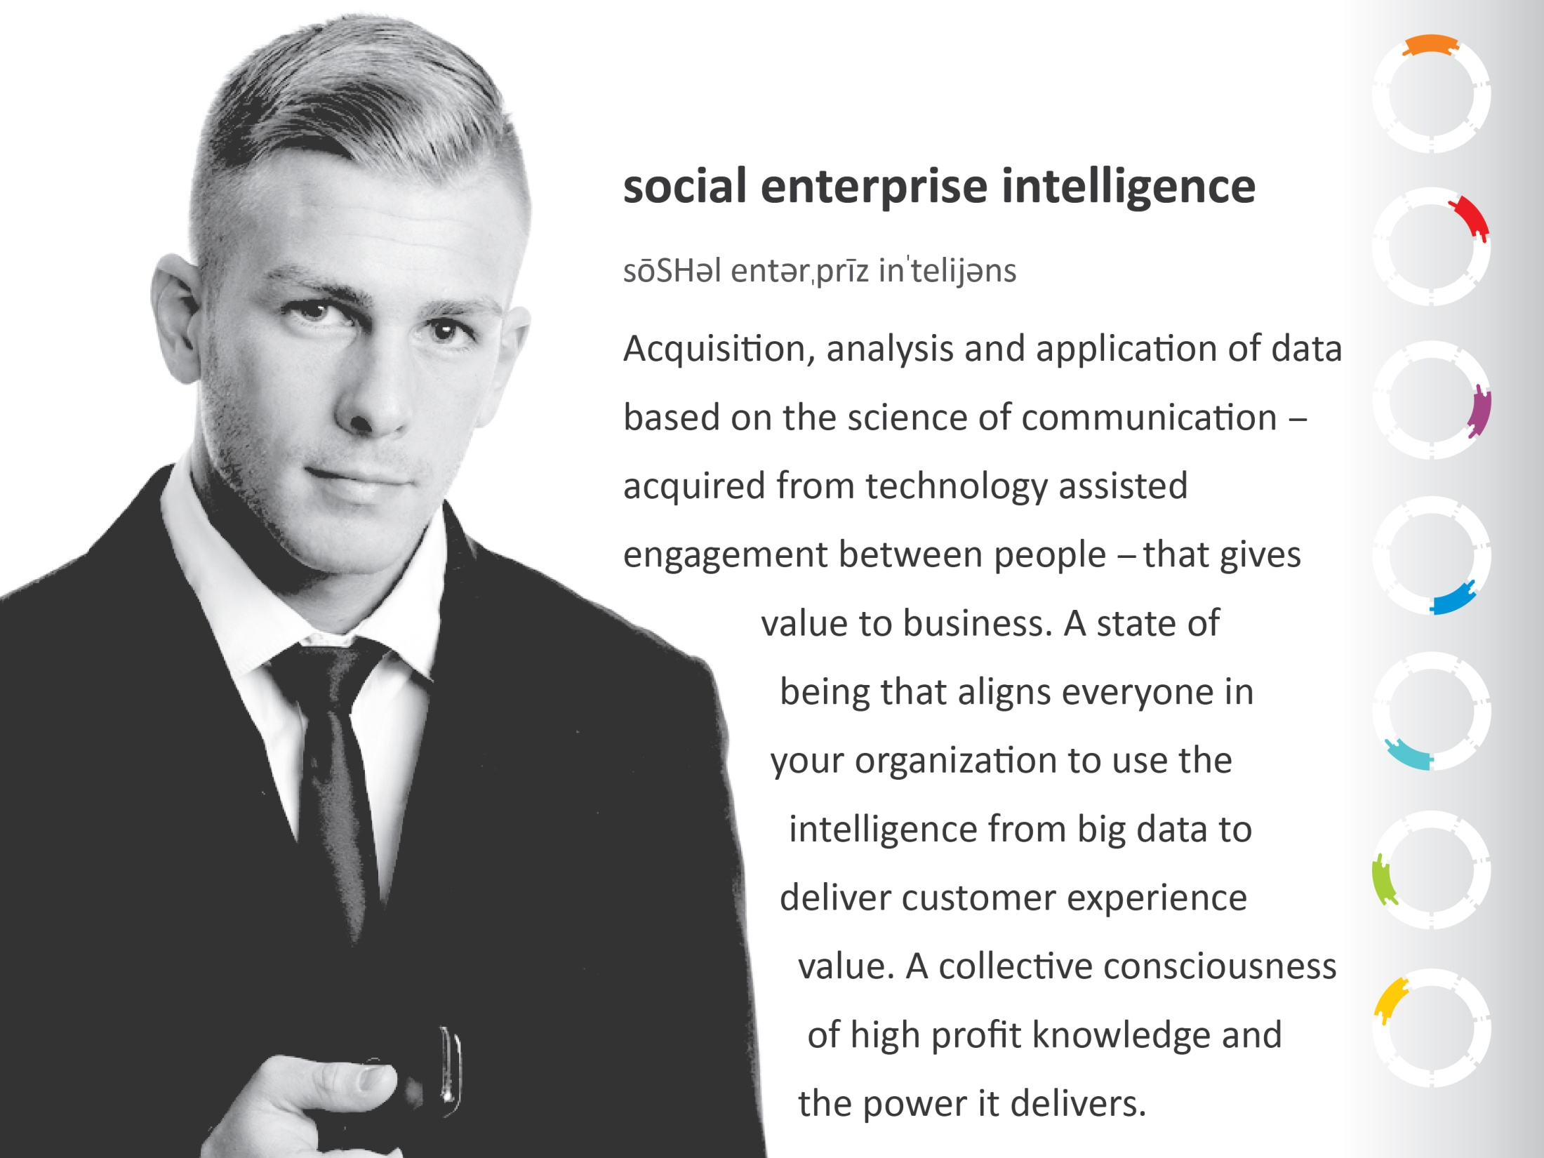
Notes:
KIM COMMENTS
Pronunciation serves two purposes: establishes the term perceptually as something you’d find in Websters, and indicates that what follows is a definition.
Science of communication: That’s the big differentiator – maybe another term in place of science – but the bottom line is that we’re talking about using lexicons to multi-level profile social media users demographics. So we all need to discuss what we call the “widget”… The way we’re filtering the data is our widget/shiny object.
Science of communication relates to the new language being created every day by social media users, and the lexicons long established for specific purposes, industries, etc.
It’s the people who make big data work for you, not the data itself…
PEOPLE + TECHNOLOGY = DATA + FILTERED = INTELLIGENCE that PEOPLE use to improve PROCESS = VALUE… we are emphasizing this repeatedly throughout this presentation
DISCUSSION TOPICS:
What does your organization know about/do about leveraging social media?
If we said SEI to you, what would you think it represented?
What are the frustrations/confusions/fears you have around leveraging social media?
SEI is possible because of current, existing and developing technologies.
Nobody is doing MetaOps SEI except MetaOps, but everyone is doing something to tap the power of social media data.

Slide 3

SOCIAL
MEDIA vs. INTELLIGENCE
DIALOGUE
Online conversation.
Some personal,
candid, in natural
social language.
Some professional,
guarded, and care-
fully articulated.
DATA
That uses the science
of communication and
lexicons to identify
value to business.
Notes:
KIM’S NOTES:
The way people present their ideas in SM types them demographically. See AARP article (we’ll get the study if we can)
Left graphic is the colors of language, conversations, everything going every which way…
The right graphic is the hard data filtered out and get us ON TARGET…
DISCUSSION ITEMS:
Discuss how never before has there been conversation between so many so much of the time, and two-way discussion/influencer conversation
Social media networks have become an integral part of how people live and work
Connected to the network 24/7 and Mobile devices are always within reach
New definition of friends, followers, influencers, two-way conversation…
Discuss what this means in regards to quantity and quality of data
And picking out and properly using the relevant data
Discuss relevant elements of social media
If you’re in business, ignore the power of “social” at your own risk
Everyone uses Social Media…
Facebook
Twitter
LinkedIn
Youtube
Blogs
Mobile
Bulletin Boards
Reviews, comments
And the list grows every day…
Scale of 1 to 10, 10=high, how important are social media and intelligence to your organization?
How would you characterize ‘success’ if you used social media intelligence data in your business?

Slide 4

B2C SOCIAL INTELLIGENCE
The things we share
on our own time,
with our friends,
family and coworkers
with whom we have a
personal relationship.
These dialogues are in the hot zone – they may include impassioned opinions, spicy language, declarations of hate and love…
Ideas are exchanged, stories are told,
concepts are opined in this zone,
and the data amassed is the type of
intelligence that goes straight to
the heart of your customer… and
straight from your customer’s
heart to you.
Notes:
KIM’S NOTES:
Data looks different if it’s B2C from B2B… we gather, filter, target and use it the same way… same process just different lexicons determine whether the conversations are social or professional.
DISCUSSION POINTS
How B2C social intelligence differs from B2B
Uses different lexicons, i.e. urban slang
Is emotion based
Reflects unfiltered opinion
Is in-the-moment/candid
Is likely to be summarized/straight to the meat of the issue
Etc.
This type of data helps a company talk the talk and walk the walk of their customer

Slide 5

B2B SOCIAL INTELLIGENCE
The things we share in a professional
manner – often as a means to an end,
i.e. to market the organization or sell
influencers about services.
These dialogues are in the cool zone –
they are likely to be thoughtful,
analytical and well communicated.
This data
is intellectual,
professionally
“packaged.”
It profiles your
markets for
fast action and
gives you service
and product
demand insight.
Notes:
DISCUSSION TOPICS
This type of data comes from social media users who you would like to have on your payroll. Free quality, maybe industry specific intellectual labor.

Slide 6

SCIENCE of COMMUNICATION
=
INTELLIGENCE
“Same
exact items,
25% more
than anyone
else. Hiss.”
“>: (,
Broke b4
I got home.
WTF?”
“No one
in my building
can afford to buy.
If they go that route,
they need to do
rent-to-own.”
“That
store’s swagg.
Manager’s
bomb.net”
“Just
call their
customer Service,
they know the
issue, they’re
good.”
“Hate
the way that
commercial
makes all of us
look stupid!”
“I can’t
believe I got that
Great insurance
plan for half what
the other guys
charge. LOVE it!”
Notes:
DISCUSSION TOPICS
What does the dialogue mean? What does the data mean?
Who is saying what?
What do we say back?
What would it be worth…
To quickly and effectively resolve a customer complaint before he tells the world?
To know what is happening when it is happening?
To actively engage in the online conversation when and where it is happening?
To be able to head off potential customer issues?
To solve an internal problem before it affects many other customers?
To identify unmet needs and wants?
What’s the impact of a customer complaint in today’s social media?
A “bad” experience can quickly get out of hand…
Customer complains on Facebook, Twitter, Google + or Yelp
"Friends" immediately chime into the public conversation with their own complaints about the company
Negative PR goes "Viral"
Competitors join into the conversation...
Weeks later someone at the company finally acknowledges the complaint
The damage is done
PR and Marketing go into "damage control" or "crisis management" mode

Slide 7

What they’re talking about.
What’s going to go viral.
The
BUZZ
The
#!*+
What went wrong.
What you are doing right.
The
BOMBS
The
KUDOS
What they really follow.
What they know that you don’t.
The
FANS
The
R&D
What ticks them off.
What they researched.
The
BOOS
The
DATA
Notes:
DISCUSSION TOPICS
Now you have your organization’s finger on the pulse of social media data… What does that mean to you?
You can monitor online reputation leads to early identification of issue
Company employee responds to customer directly on the same social platform used to post a complaint
Immediate response aimed at communication and resolution
Quick response enhances reputation of company
Positive PR goes viral
Behind the scenes…
The responding employee leverages the internal online knowledge base and internal network to enlist support from his peers in resolving the issue
Functional areas and process managers are notified of the issue
Trends are identified
Problem is resolved in Manufacturing, eliminating future complaint
Provide critical information for process improvement tracking

Slide 8

YOUR
STAKEHOLDERS
all benefit from
the value of
SEI
YOUR CUSTOMER/CLIENT
YOUR TEAM
People are talking, technology is listening, we’ll help you hear them.
SM users are doing research for you – for free.
SM users are doing your R&D for you – for free.
SM users are doing your market analytics for you – for free.
And that’s just the beginning…
Tap into your billion-strong free workforce with Social Enterprise Intelligence.
Notes:
DISCUSSION TOPICS
If folks freak out about Big Brother, they aren’t going to be our customers because they’ll feel that using the data is unethical… this is a good time to find out!
All your stakeholders benefit because SEI adds value that positively impacts your customers, your clients, your team… you>
SOCIAL ENTERPRISE INTELLIGENCE…
Aligns with business objectives and supports achieving tangible business results
Uses the tools, technologies and processes of social media, social networks and social business
Cuts across multiple business functions and processes
Improves and accelerates your ability to “go deeper, faster” by using automated tools, analytics and communications

Slide 9

The technology to gather data exists on every social media platform.
Our proprietary data aggregation and communication science technology converts it into Social Enterprise Intelligence.
SOCIAL: DATA AQUISITION
Notes:
KIM’S NOTES:
This is the raw DATA phase…
DISCUSSION TOPICS
They are talking, the technology is listening, you can hear them now…
At the very least, data is available through social media platform developer interfaces; many platforms have sophisticated data retrieval systems.
We don’t reinvent their technology, we use it; aggregating data and filtering it before communication science analysis.
We deliver your intelligence asset – making social media dialogue relevant to and valuable across all departments of your organization.

Slide 10

Our system asks and answers:
Who said it?
What did they mean?
Who cares?
Better yet, it tells us:
Do they lead or follow?
Are they down or uptown?
Are they a C or B?
Then it ranks them on
…among other things (many)
are they free contributors to:
Sales?
Marketing?
Customer Service?
Product/Service R&D?
HR & Staffing?
Globalization…?
…and when we reach back out to them:
How do we speak?
What makes the connection?
Why would they be eager to make it?
INTELLIGENCE:
DATA ANALYSIS
Notes:
KIM”S NOTES:
This is the phase when the raw data becomes intelligence… it asks and answers the who, what, when, where and why…
DISCUSSION TOPICS:
Our proprietary data filtering and analysis system…

Slide 11

ENTERPRISE: LEVERAGING THE DATA, NOW…
We know who is saying what and how to talk to them.
We know who their influencers are and how to influence.
We know what social languages they speak, and we speak.
We know what they like, dislike, dream of, spend money on…
Now, we can fulfill their dreams and optimize their expenditures.
Our Social Enterprise Intelligence system tells you how to improve your products and services for greater market share, how to hit your marks in marketing and sales, where to find new customers and clients, how your customer service can build legions of loyal followers, how to reach exactly the people you want to, who you should hire and why, and when you don’t need to hire because the SEI data does the job of your marketing, R&D and other teams.
Notes:
DISCUSSION TOPICS
We know your business has objectives, ongoing initiatives, multiple departments, an internal world, and external world, and established ways of doing things… SEI, like no other tool, helps you maximize your external relationships, your internal relationships, and makes your outside world part of your inside world’s team.

Slide 12

Meet Lexicons – Our Secret Agent
Specialist: decoding languages, all languages
Social: The personal social languages of hipsters, boomers, Gens X, Y, and Z, millennials, seniors, teens, kids…
Societal and Cultural: The urban and rural vernaculars “of the street,” slang, gang, jargon, down south, up country, way north…
Ethnic and ESL: Spanish, Portuguese, Italian, Russian, Korean, German, Vietnamese, Tagalog, French, Chinese…
Social Media and Texting: Language variants from the modified grammar, syntax and spelling of texting, tweeting, pinning…
Business and Finance: Common and uncommon words
and phrasing that are corporate-world specific…
Science and Technology: Language of the glo-
bal geek squad from reception to C-suite…
Specialty: Everything else, i.e. medical…
Notes:
DISCUSSION TOPICS
This exclusive MetaOps tool make this possible: we speak the language, so we know the speaker.

Slide 13

Meet Our Profiler – Our Secret Weapon
Specialist: extracting and combining the information that matters
Social Language: Delivers global and specific demography from age, gender, and general interests to passions, peeves and perceptions.
Societal and Cultural: Allows us to create the snapshot of the world each person lives in: where and how they live and why.
Ethnic and ESL: Gives us culture-based demography, lifestyles, customs, habits…
Social Media and Texting: Translates the “code” of the
“third language” into meaningful intelligence.
Business and Finance: Unlocks secrets of business.
Science and Technology: Lets us use information
we couldn’t understand before.
Specialty: Unlocks mystery speak of all kinds.
Notes:
DISCUSSION TOPICS
This exclusive MetaOps tool groups information by purpose, ranks that information when there are multiple purposes by what its value is and to whom, and how to leverage the value for benefit.
Note: Spoken and written are the first two languages, social media is the third; encompasses the changes in the way we “talk” re SM slang, texting abreviations, lexicons developing for various platforms…

Slide 14

Meet Our Chemist – Code Name: Delivery Boy
Specialist: creating the chemistry between you and them…
IF you need 1,000 billion dollar company executives,
each with a penchant for supplying their employees
with the latest and greatest tech gadgets , THEN
we’ll deliver them to you.
IF you just launched a new product, sold
300 million units and want the candid skinny on
what your customers do and don’t like about
it, THEN we’ll deliver that data.
IF you want to start creating products
and/or services based on consumer
demand instead of research and
s.w.a.g., THEN we’ll find out what they
really, really want and deliver the
“blueprint(s).”
IF you want to break into a new and
untried market, THEN we’ll deliver
the intelligence that tells you where
to break in, how to break in, and if
the risk will deliver the results
you want.
Notes:
DISCUSSION TOPICS
This is the exclusive MetaOps tool that combines groupings of data, from lexicon based profiling to deliver intelligence

Slide 15

We could tell you
how we do it,
but then
we’d have
to kill you.

Slide 16


But we will
tell you, show you, and
make it possible for you to
Monetize Social Media
We know you are using or plan to use social media big data to achieve your organization’s goals.
We know your investment in doing so may be high and your returns low.
We know Social Enterprise Intelligence changes that paradigm entirely.
SEI is the right data
SEI delivers data painlessly
SEI is external & internal
SEI is strategy
SEI aligns your people
SEI de-silos your organization
SEI delivers extreme value to your customer
SEI is a collective state of being & doing
Notes:
DISCUSSION POINTS
Detail on each bullet… needs to be fleshed out

Slide 17

SEI is Change Management: SEI
changes departments, it changes
jobs, it changes how you do
everything you do.
SEI is Business Process Improvement: SEI improves how you communicate, how you manage your value stream,
How you deliver customer service.
SEI is Internal Intelligence: SEI
uses your organization’s social media culture to improve leadership and foster team congruence and alignment.
SEI is External Intelligence: SEI turns your fans, followers, critics and customers into your extended team of brand ambassadors and contributors.
Social Enterprise Intelligence Marries Knowledge to Business Process
without this congruence, the data is meaningless and ineffectual
Notes:
KIM’S NOTES:
Vision
Management of Change
Impetus for Change – comes from the environment
Strategic Leadership – change in the environment is a continuous process
With SM/Big Data and the speed with which people communicate is the environment the REQUIRES change to happen
Minimizing resistance to organizational change through buy-in from key players and team members = alignment/congruence

Slide 18

What we do
Why do you need us?
We are Social Enterprise Intelligence so
you can be an intelligent Social Enterprise.
We amass the best data
We code it and filter it
We analyze it for purpose
We plug it in for you
We track its performance
Our agents turn your team into SEI agents
Your team becomes customer value centric
Your organization becomes a social enterprise
Your profitability is greatly and sustainably transformed
You maintain gain, not pain
Data > Intelligence > Knowledge > People > Collective Application > The Future of Business, Now
Notes:
KIM’S NOTES:
Summary that fosters questions, clarifications, further discussion relevant to potential client… Interested in finding out what team thinks should be here, and how to slam it home.

Slide 19

Social Enterprise Intelligence is based on the science of communication.
The science of communication is based on the science of human behavior.
MetaOps, Inc. changes business by changing human behavior.
We use proven methodologies to move people from fear to embracing change, then competently executing sustainable business process improvement, quickly and profitably.
Notes:
This slide is NOT complete – ran out of time. Need to tighten up closing message…

Slide 20

THE ONLY SOCIAL MEDIA MAXIMIZATION YOU’LL EVER NEED
brought to you exclusively by your central business intelligence agency

